Slide 1

OFFICE OF EDUCATION QUALITY ASSURANCE
PRIVATE EDUCATION AND SPECIAL PROGRAMMES DEPARTMENT
Office of Education Quality Assurance
Block 5, 1st Floor, The Secretariat, Obafemi Awolowo Way, Ikeja, Lagos, Nigeria.
E-mail: info@oeqalagos.com support@oeqalagos.com

Slide 2
INTRODUCTION - BRIEF OVERVIEW
The PESP Department is responsible for the provision of guidelines and policy directives to private schools on important matters of education.
The Departments comprises of Five (5) Units .
Education Quality Assurance Services Unit (School Pre-Reg)
School Approval Unit
Verification And Documentation Unit (Access & Revenue)
Accreditation Unit (WAEC & BECE)
Special Programmes and Intervention Unit

Slide 3
FUNCTIONS OF THE DEPARTMENT
Approval of Private Institutions below the tertiary level
  Documentation, Site and Approval Inspections.
Organizing Special Programmes such as
  Spelling Bee, School Invention Platform (SIP) Family Life and HIV Education
Updating and retrieving information from the database

Slide 4
FUNCTIONS OF THE DEPARTMENT..2
Issuance of Demand Notice and collection of Annual Dues through the Central Billing System (CBS).
Organizing Stakeholders meeting with Private Schools.
Collaborating with PPRS on Annual School Census.
Reviewing of Guidelines on Establishment of Private Institutions

Slide 5
III. Unit Activities – Education Quality Assurance Unit
    School Pre-Registration
    Replacement of Loss of Approval Letters
    Change of Ownership
    Change of School Location / Address
    Change of School Name
    Confirmation of School Status
    Request for list of schools
    Voluntary Closure/Suspension of School

Slide 6
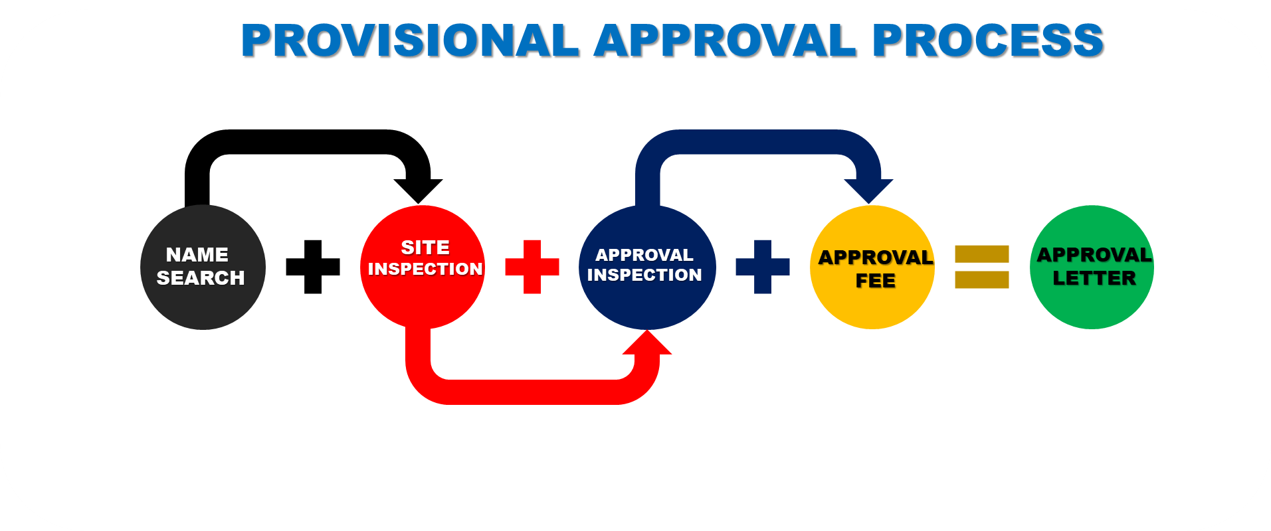
III. Unit Activities - School Approval Unit
  Site /Revisit Inspection
  Approval Inspection
  Approval Fee
  Issuance of Approval Letters
School Registration
School Pre-Registration
Provisional Approval

Slide 7
ACCREDITATION UNIT
Co-ordinates Full Scale Subject Recognition Inspection (SRI) to qualify new public and private schools for external examinations such as WAEC, NECO & BECE.
The objectives of the exercise are as follows;
  Quality of teachers
  Availability and adequacy of facilities
  Functionality of statutory records
At the end makes available final Accreditation Report for 3

Slide 8
Verification & Documentation Unit
(Access & Revenue)
Fill annual due renewal form online
Generate Invoice as payment advice
Issue Clearance letters to Schools after payment and verification of required documents.
Attend to petitions & Complaints from Schools as regards Annual Due.

Slide 9
Special Programmes, Coordination & Intervention Unit
The Unit oversees specific programmes, coordinate and collate the monthly, quarterly and annual reports of the Department.
SPECIFIC ACTIVITIES INCLUDE:
Spelling Bee Competition
One –Day Governor
School Invention Programme
United Nations Drug Free Day Celebration
World Aids Day Celebration

Slide 10


THANK YOU
OFFICE OF EDUCATION QUALITY ASSURANCE
(OEQA)
Excellence in Education
Block 5, 1st Floor, Ministry of Education,
The Secretariat, Ikeja, Lagos, Nigeria.
www.oeqalagos.com
www. lagoslearnstogether.com
info@oeqalagos.com, support@oeqalagos.com

